Slide 1
Interactive web documentaries. A case study: iOtok.
Julie Ducasse

Slide 2
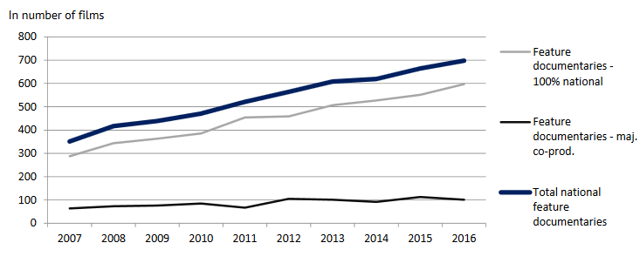
Some facts
The use of online videos is continuously increasing: over a billion of hours of video every day on YouTube!
Documentaries are more and more popular (European Audiovisual Observatory)
An opportunity for online (and interactive) documentaries

Slide 3
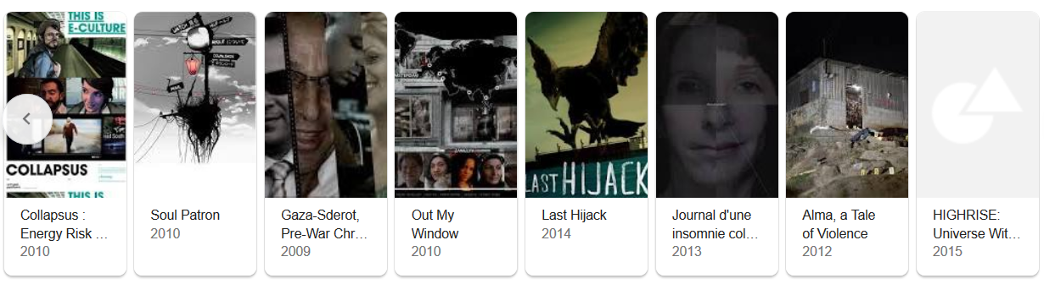
Some facts
Online and interactive documentaries are also getting more and more popular:
Any documentary that uses digital interactive technology to document the “real”
But do interactive documentaries “work”?

Slide 4
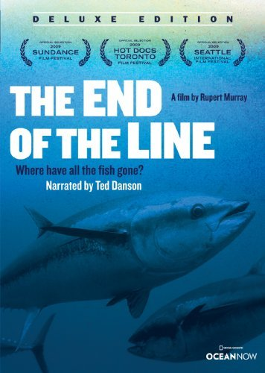
One example of a successful documentary
A documentary about the devastating impact of over-fishing (UK, 2009)
Results from impact study:
9.3% of the UK population aware of the film (1:510)
Changes of fish buying/sourcing policies (e.g. Pret A Manger, Marks and Spencer)
Waitrose announced a positive 15% increase in sustainable fish sales in the four weeks following the film’s release
Creation of a website that rates restaurants according to their sustainability
Creation of a new charity that raised $5 million for a no-take marine reserve
A (interactive) documentary “work” if it achieves some impact

Slide 5
How can web-docs achieve impact?
People are accessing the website
People consume & understand the content
People change their mind and behaviors
People talk about it / build communities
Societal structures change
Audience reception
User experience:
- Engagement
- Understanding
- …
Social impact (for issues-focused documentaries)

Slide 6
Why research on web-docs is important?
People are accessing the website
If we know who is the audience, why/how/when people reach the website,
we can reach more people.
People consume & understand the content
If we know how people interact with the website, why they leave/stay/return, we can have more people consuming the content.
People change their mind and behaviors / structures change
If we know what makes people change their mind, what motivates them to build communities, we can achieve a greater impact.

Slide 7
How to answer these questions?
People are accessing the website
Number of visits; time of visit; audience demographics; correlations between social media activity and number of visits, etc.
People consume & understand the content
Engagement: number of clicks; time spent on the website, number and frequency of visits per user; use of social media features; emotions
Understanding: questionnaire, interview
People change their mind and behaviors / structures change
Press coverage, petitions, change of public policies, campaigns, etc.

Slide 8
Our methodology: iOtok, a case study
One interactive web-doc & data from real users:
Users’ logs: all events on the web portal during 14 weeks > 20 000 sessions
Google Analytics
Facebook Analytics
MailChimp (newsletter)
Online questionnaire (56 users)

Slide 9
iOtok
An interactive web documentary by Miha čelar

Slide 10
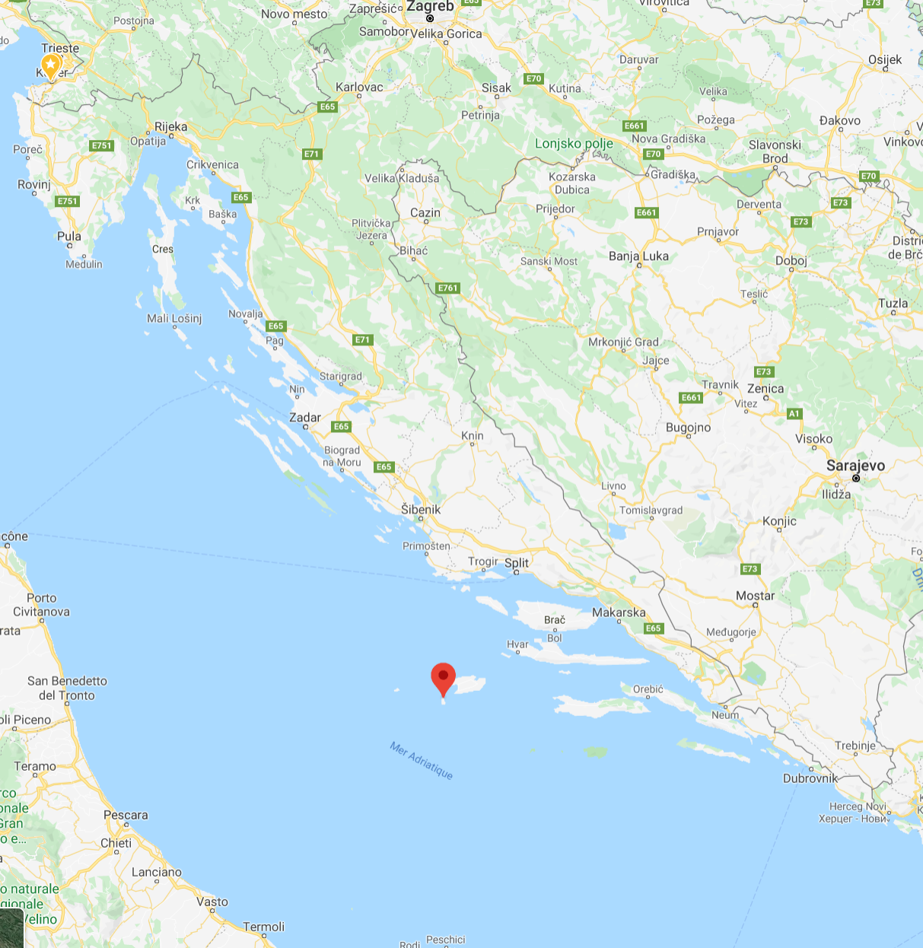
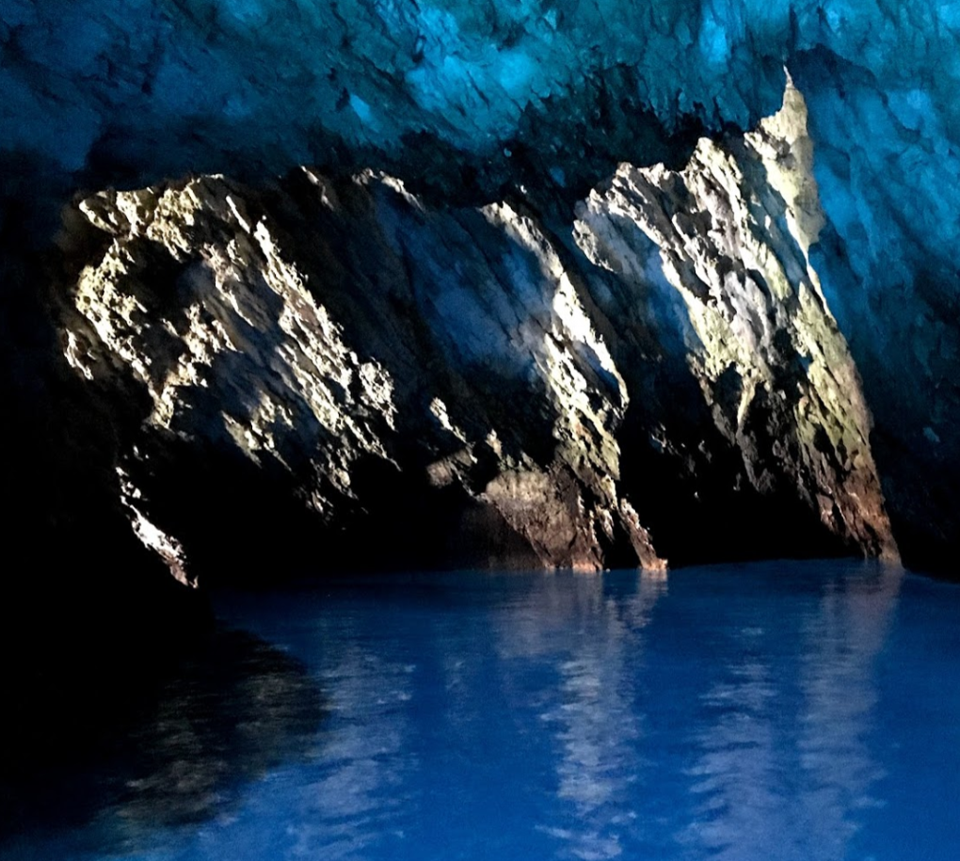
The story
Biševo, a small Croatian island
… with more and more tourists
… and 13 inhabitants only
… and a mayor willing to convert the school into a multimedia center
13 episodes released each Monday for 13 weeks. Each episode = the voice of one inhabitant / one couple

Slide 11
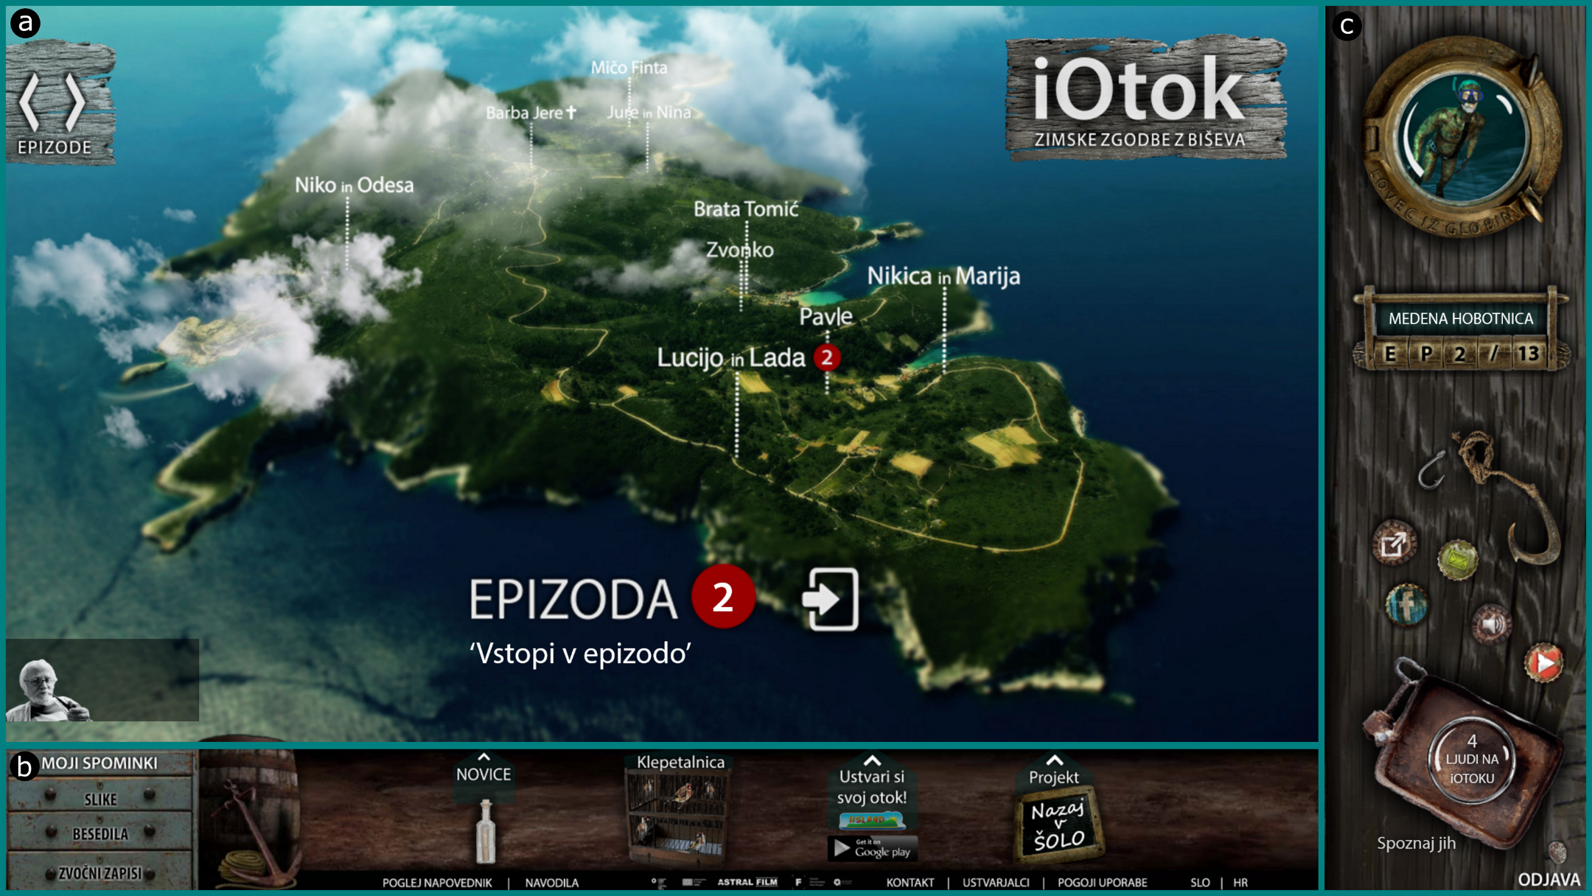
The webportal

Slide 12
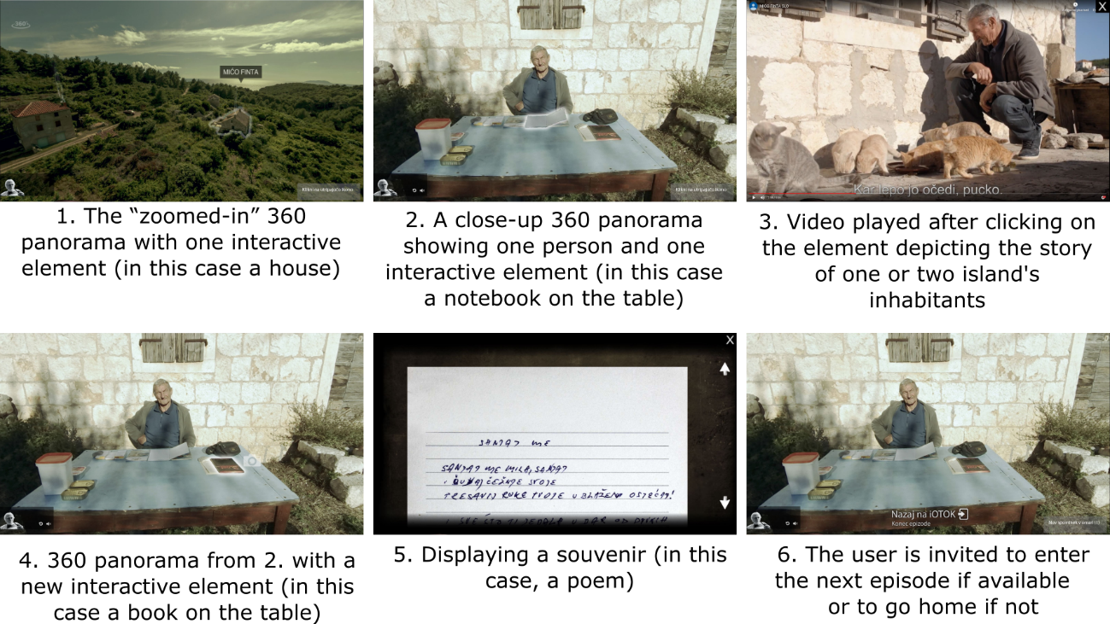
Episode structure

Slide 13
Promotion of the episodes
Episodes released on Mondays
Online news portals and newspapers (weekly promotion) :
dnevnik.hr
rtvslo.si
enavtika.si
dalmatia.hr
…
Facebook (2 pages): every week
Post on Friday
Post “boosted” on Sundays
Newsletter for registered users
Every Monday morning at 6.45 a.m.

Slide 14
Audience reception
People are accessing the website
People consume & understand the content
Change of mind/behaviors/structures
Who? How MANY? WHEN? From WHERE? WHERE? How?

Slide 15
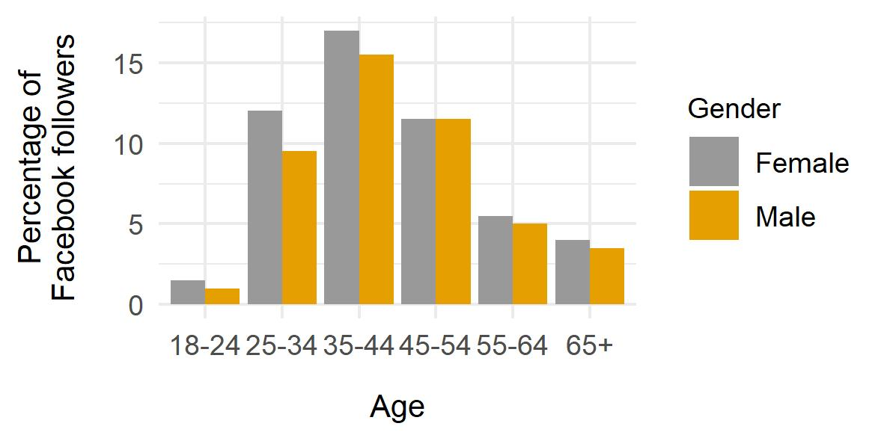
WHO?
Are these users comfortable
with interactivity?
> Audience targeted by the documentary filmmaker
Users’ logs / Facebook Analytics

Slide 16
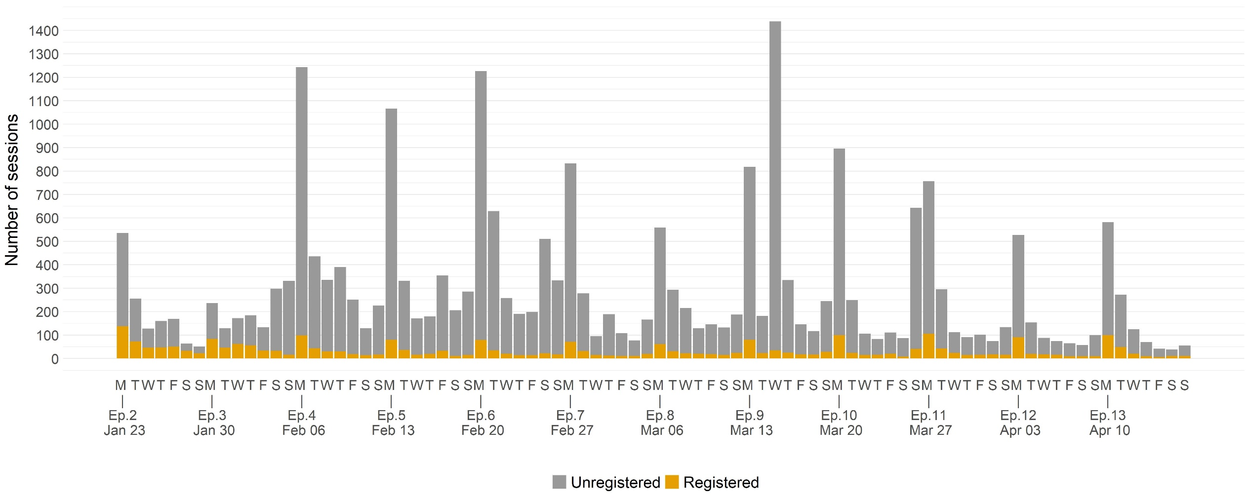
How many?
860 registered users
around 6000?
11 120 unregistered users
Users’ logs

Slide 17
Are those “good” numbers?
StoryCode’s analysis : independent productions reach 10 000 to 20 000 visitors.
Other examples:
Black Gold Boom: 25 000 visits in 1 year
Hollow: 77 000 visits in 6 months
Journey to the end of coal: 110 000 visits in 10 days
In English!
Which channels were efficient to promote iOtok?
Users’ logs

Slide 18
When?
Mainly on Mondays, for registered and unregistered users
2 peaks for unregistered users
Users’ logs

Slide 19

From where? Traffic sources
Facebook 35%
2nd peak
Direct (typing URL)
51%
Referral:
Slobodna
Dalmaciija (2%)
1st peak
Referral: Punfunker.hr 3%
Referral: RTVSLO 3%
Referral:
others 3%
Organic
search:
3%
Social media:
Others (1%)
Google Analytics

Slide 20
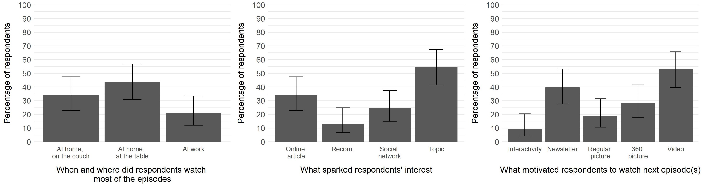
Insights from the questionnaire
Direct 51%
Referral: Punfunker.hr 3%
Referral: RTVSLO 3%
Referral:
others 3%
Organic
search:
3%
Social media:
Others (1%)

Slide 21
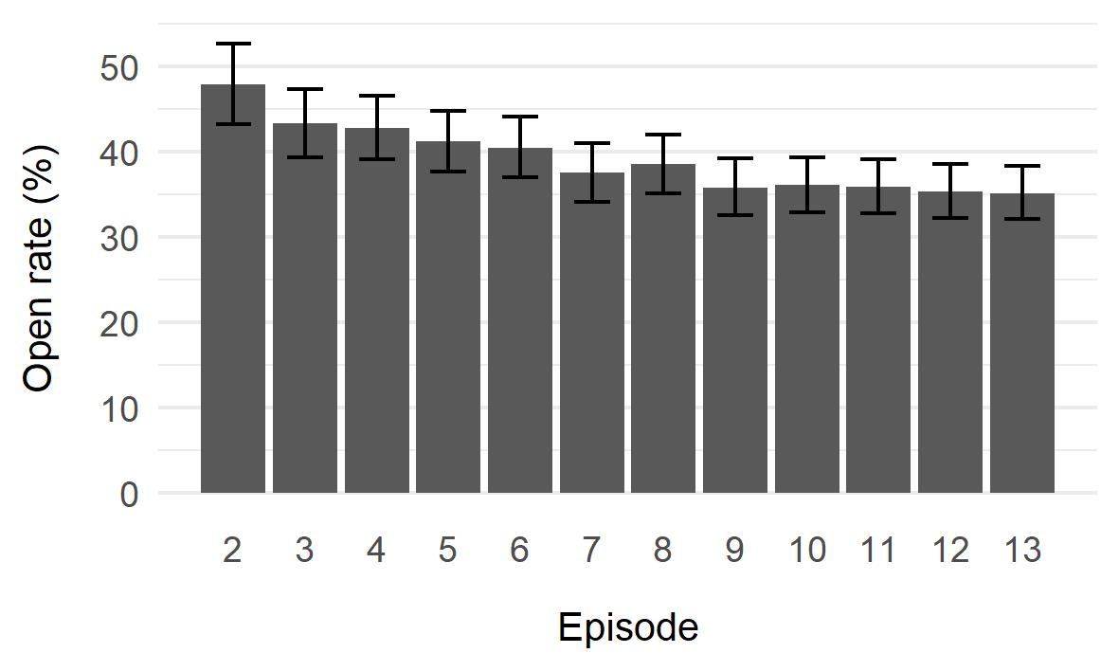
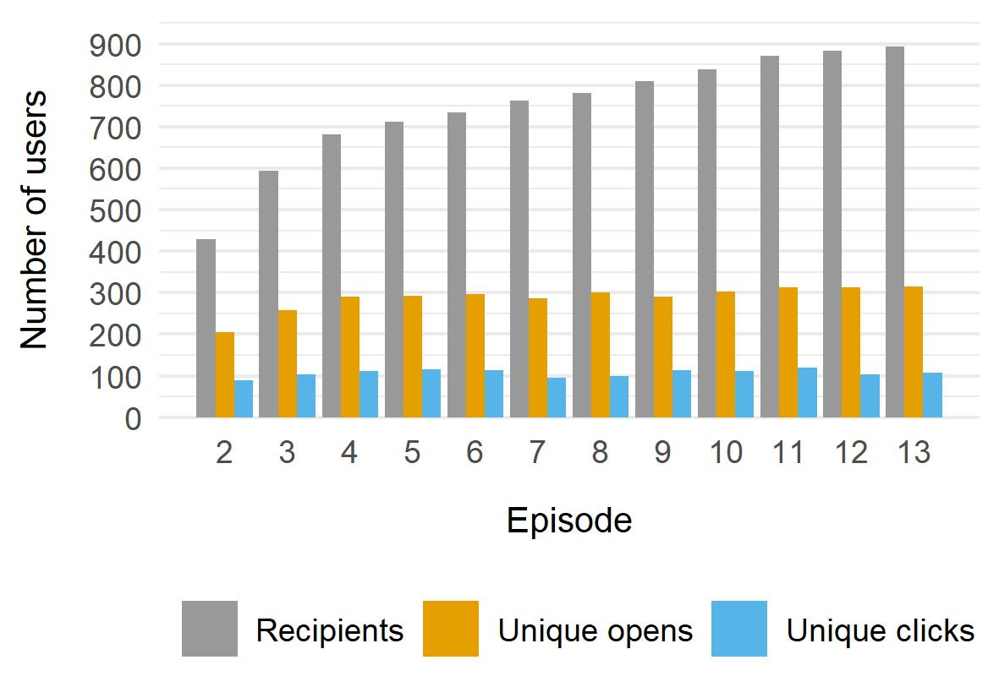
Was the newsletter efficient?
Direct 51%
Referral: Punfunker.hr 3%
Referral: RTVSLO 3%
Referral:
others 3%
Organic
search:
3%
Social media:
Others (1%)
Above the average (21%)
Around 100 users/week vs 240 sessions/week ≈ 50% of registered users
MailChimp statistics

Slide 22
Implications
To reach a larger number of people, 3 channels proved particularly successful:
Facebook (with 2500 members in 2 years)
a strategy for Facebook campaign is essential
Regional and national online articles
Newsletter, but for registered users only
encourage users to register
make registration process easier or just ask for emails

Slide 23
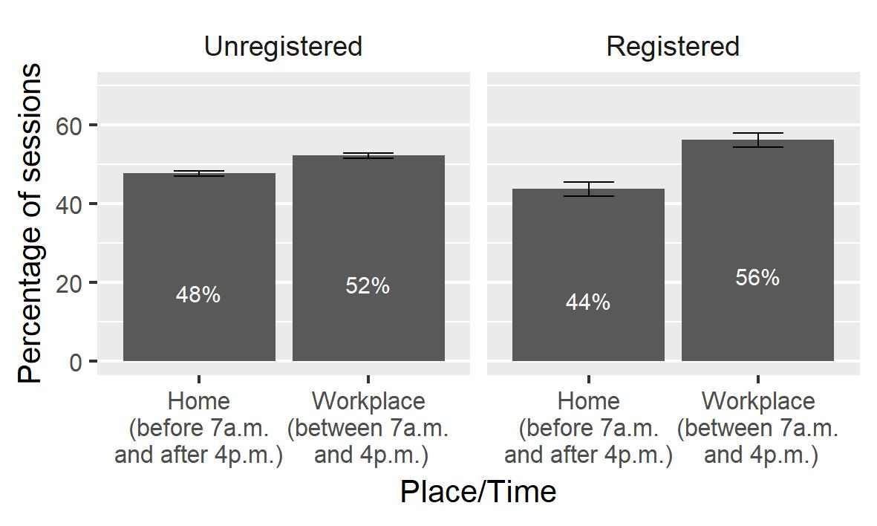
Context: when?
Direct 51%
Referral: Punfunker.hr 3%
Referral: RTVSLO 3%
Referral:
others 3%
Organic
search:
3%
Social media:
Others (1%)
Users logs

Slide 24
Context: how? Mobile or Desktop?
People wanted to access iOtok on their mobile
Google Analytics

Slide 25
Implications
People watched iOtok on their phones and/or at work :
More likely to be interrupted.
Less time to engage with the video.
Interactivity can be challenging
Provide bite-sized content / enable users to skip chapters
Make it possible for users to resume their watching, esp. across different devices
Design for mobile devices ? E.g. reduce interactivity; vertical videos
Provide subtitles (85% of Facebook videos are watched without sound)

Slide 26
User experience
People are accessing the website
People consume & understand the content
Change of mind/behaviors/structures
How often? How long? How much?

Slide 27
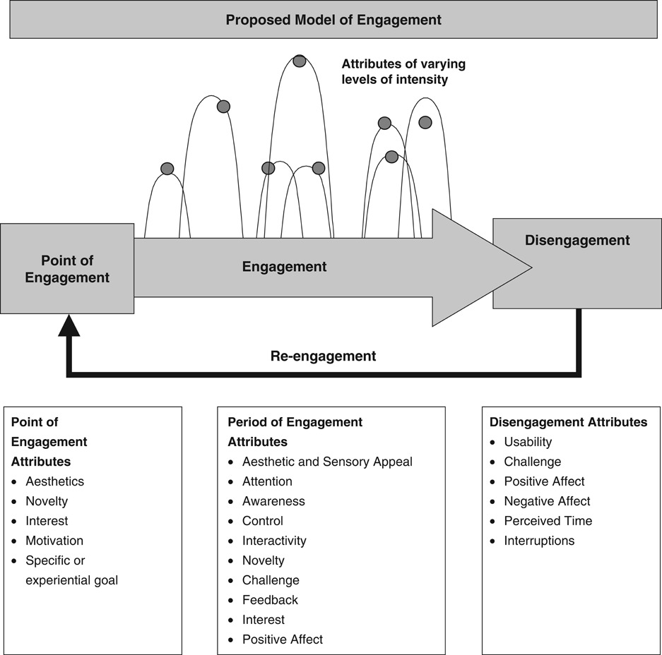
User engagement
Going through all the steps to reach the core video + watching the video
(re)visiting the website
Entering the episode
Quitting the webportal
Not coming back
What is user engagement? A conceptual framework for defining user engagement with technology. O’Brien & Toms. 2008

Slide 28
User engagement
Control – Interactivity – Feedback – Interest – Positive affect
Aesthetics
Novelty
Interest
Motivation
Specific goal
Usability
Challenge
Positive/negative affect
Perceived time
Interruptions
What is user engagement? A conceptual framework for defining user engagement with technology. O’Brien & Toms. 2008

Slide 29
Interactivity

Slide 30
Episode structure
Click on “enter episode”
Point of engagement: do users enter the episode?
Click on Interactive element
Audio narration starts
Audio narration finishes
Engagement / Possible points of disengagement
Video starts
Video closed / finished
Click on Souvenir
Close Souvenir
Point of disengagement for “perfect” registered users

Slide 31
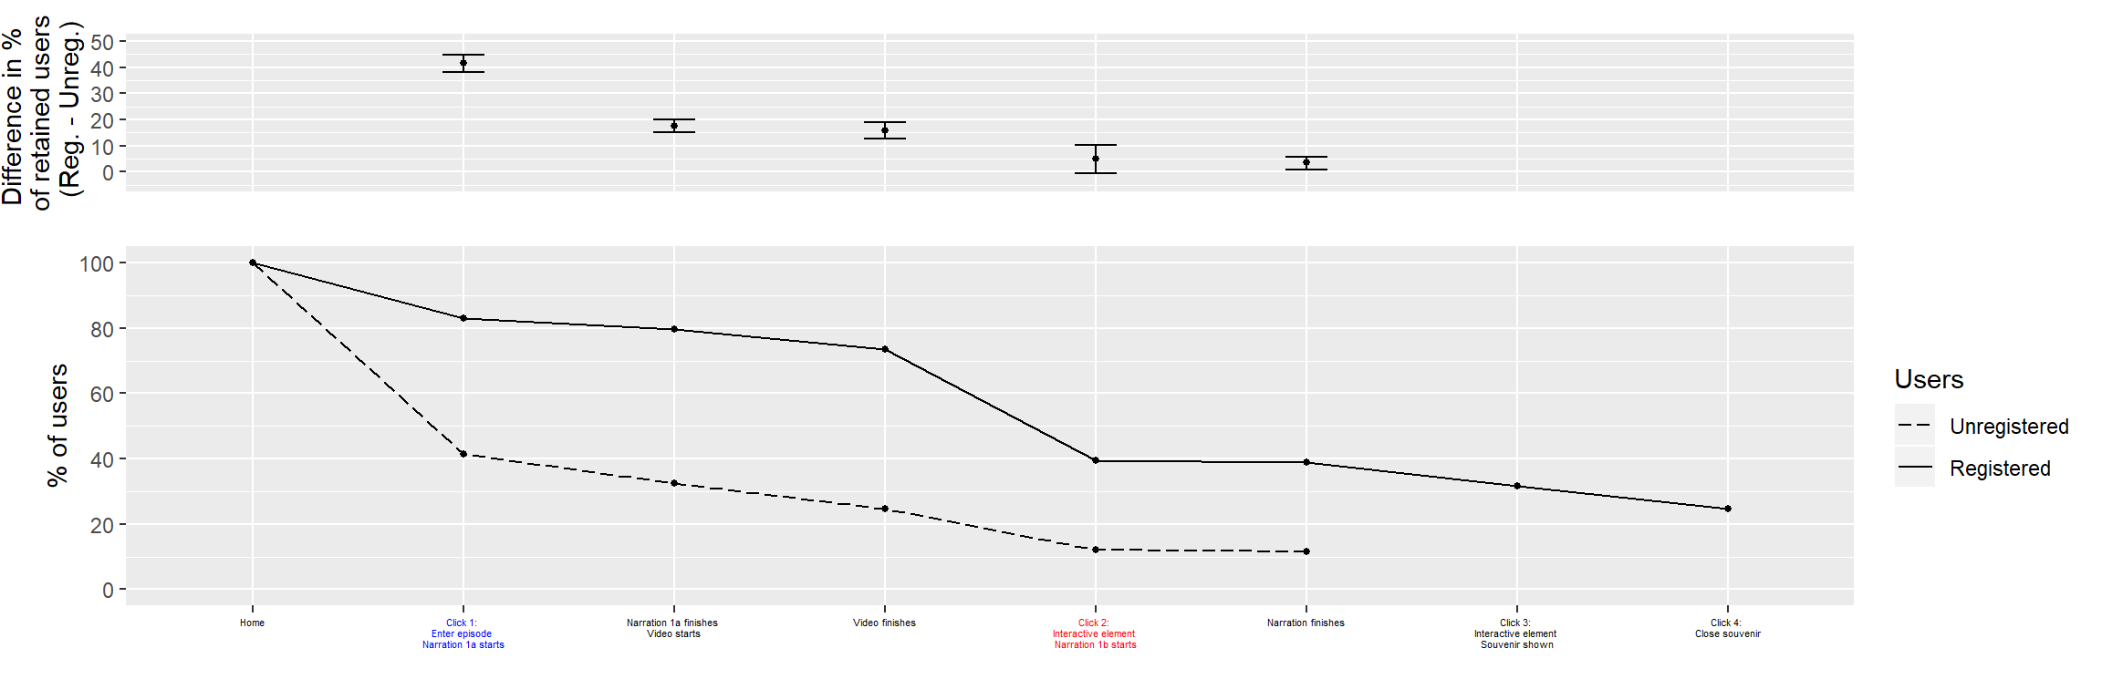
% of users at each step: Episode 1
60% of unreg. users do not enter the episode!
20% of reg. users do not enter the episode
The very first click on the panorama seems to be challenging
Registered users try out the souvenirs
1
2
3
430
- 54%
-20%
230
1270
620
- 49%
Home
Click on “enter” Narration starts
Narration finishes
Video starts
Video
finishes
Click on interactive element: Narration starts
Narration
finishes
Click on Souvenir
Click to close Souvenir

Slide 32
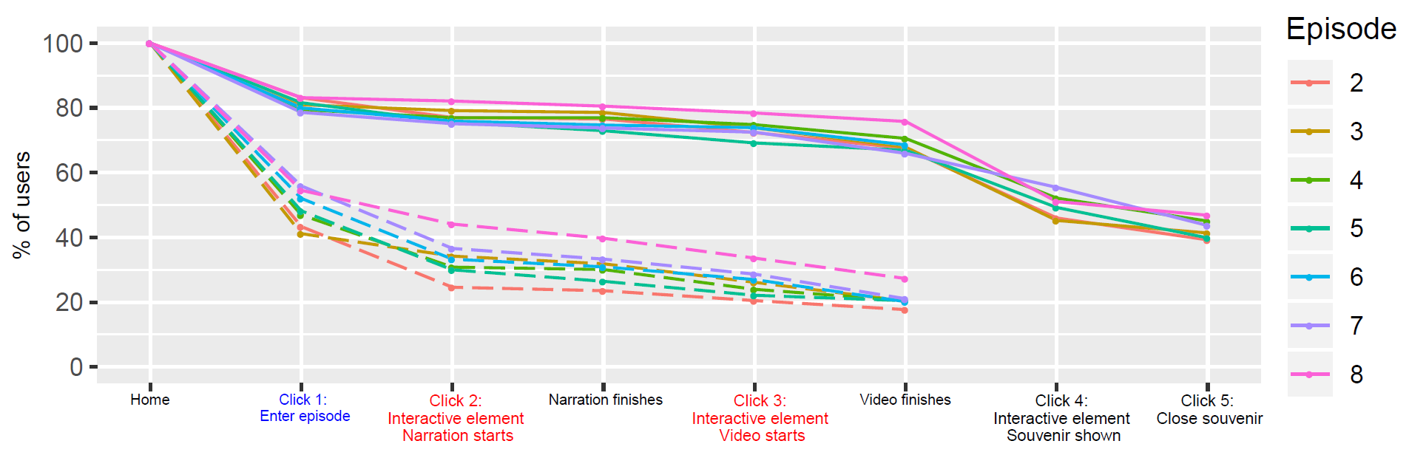
% of users at each step: Episodes 2-8
50% of unreg. users do not enter the episode!
20% of reg. users do not enter the episode
The first click is less challenging
for unregistered users
Registered users less interested in souvenirs
1
2
3
- 5%
-30%
- 30%

Slide 33
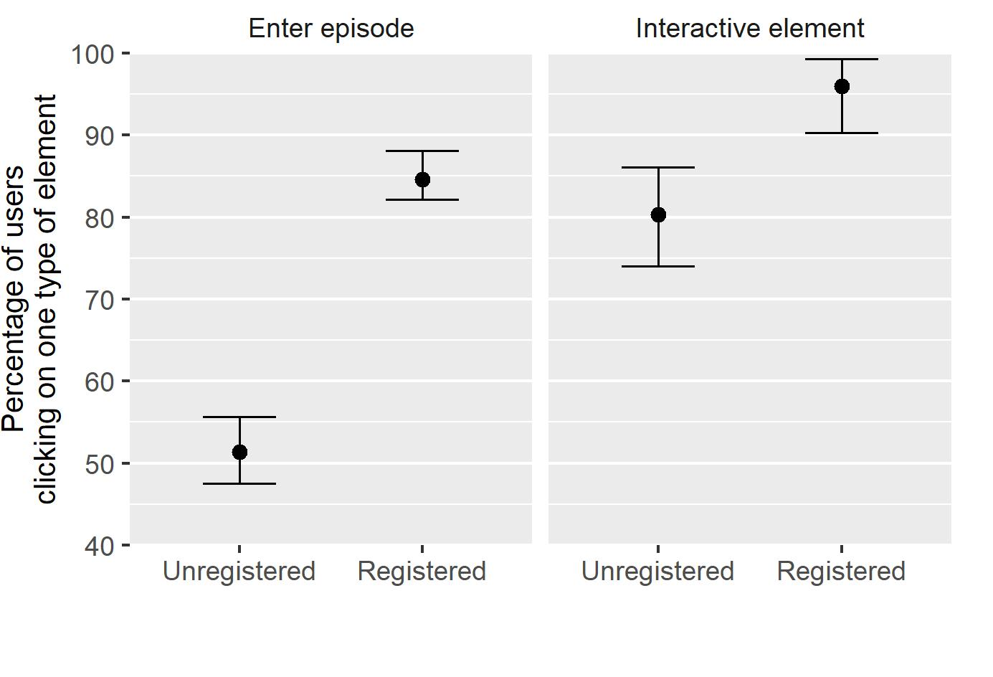
% of users at each step: summary
15%
30%

Slide 34
Reasons?
Control – Interactivity – Feedback – Interest – Positive affect
Aesthetics
Novelty
Interest
Motivation
Specific goal
Challenge
Usability
Positive/negative affect
Perceived time
Interruptions

Slide 35
Implications
Design simple/easy-to-learn interactions
For first-time visitors, make content accessible as quickly as possible
Find a trade-off between setting up the scene and letting users access the core content
Consider the added value of each click; are all steps necessary?

Slide 36
Serialization

Slide 37
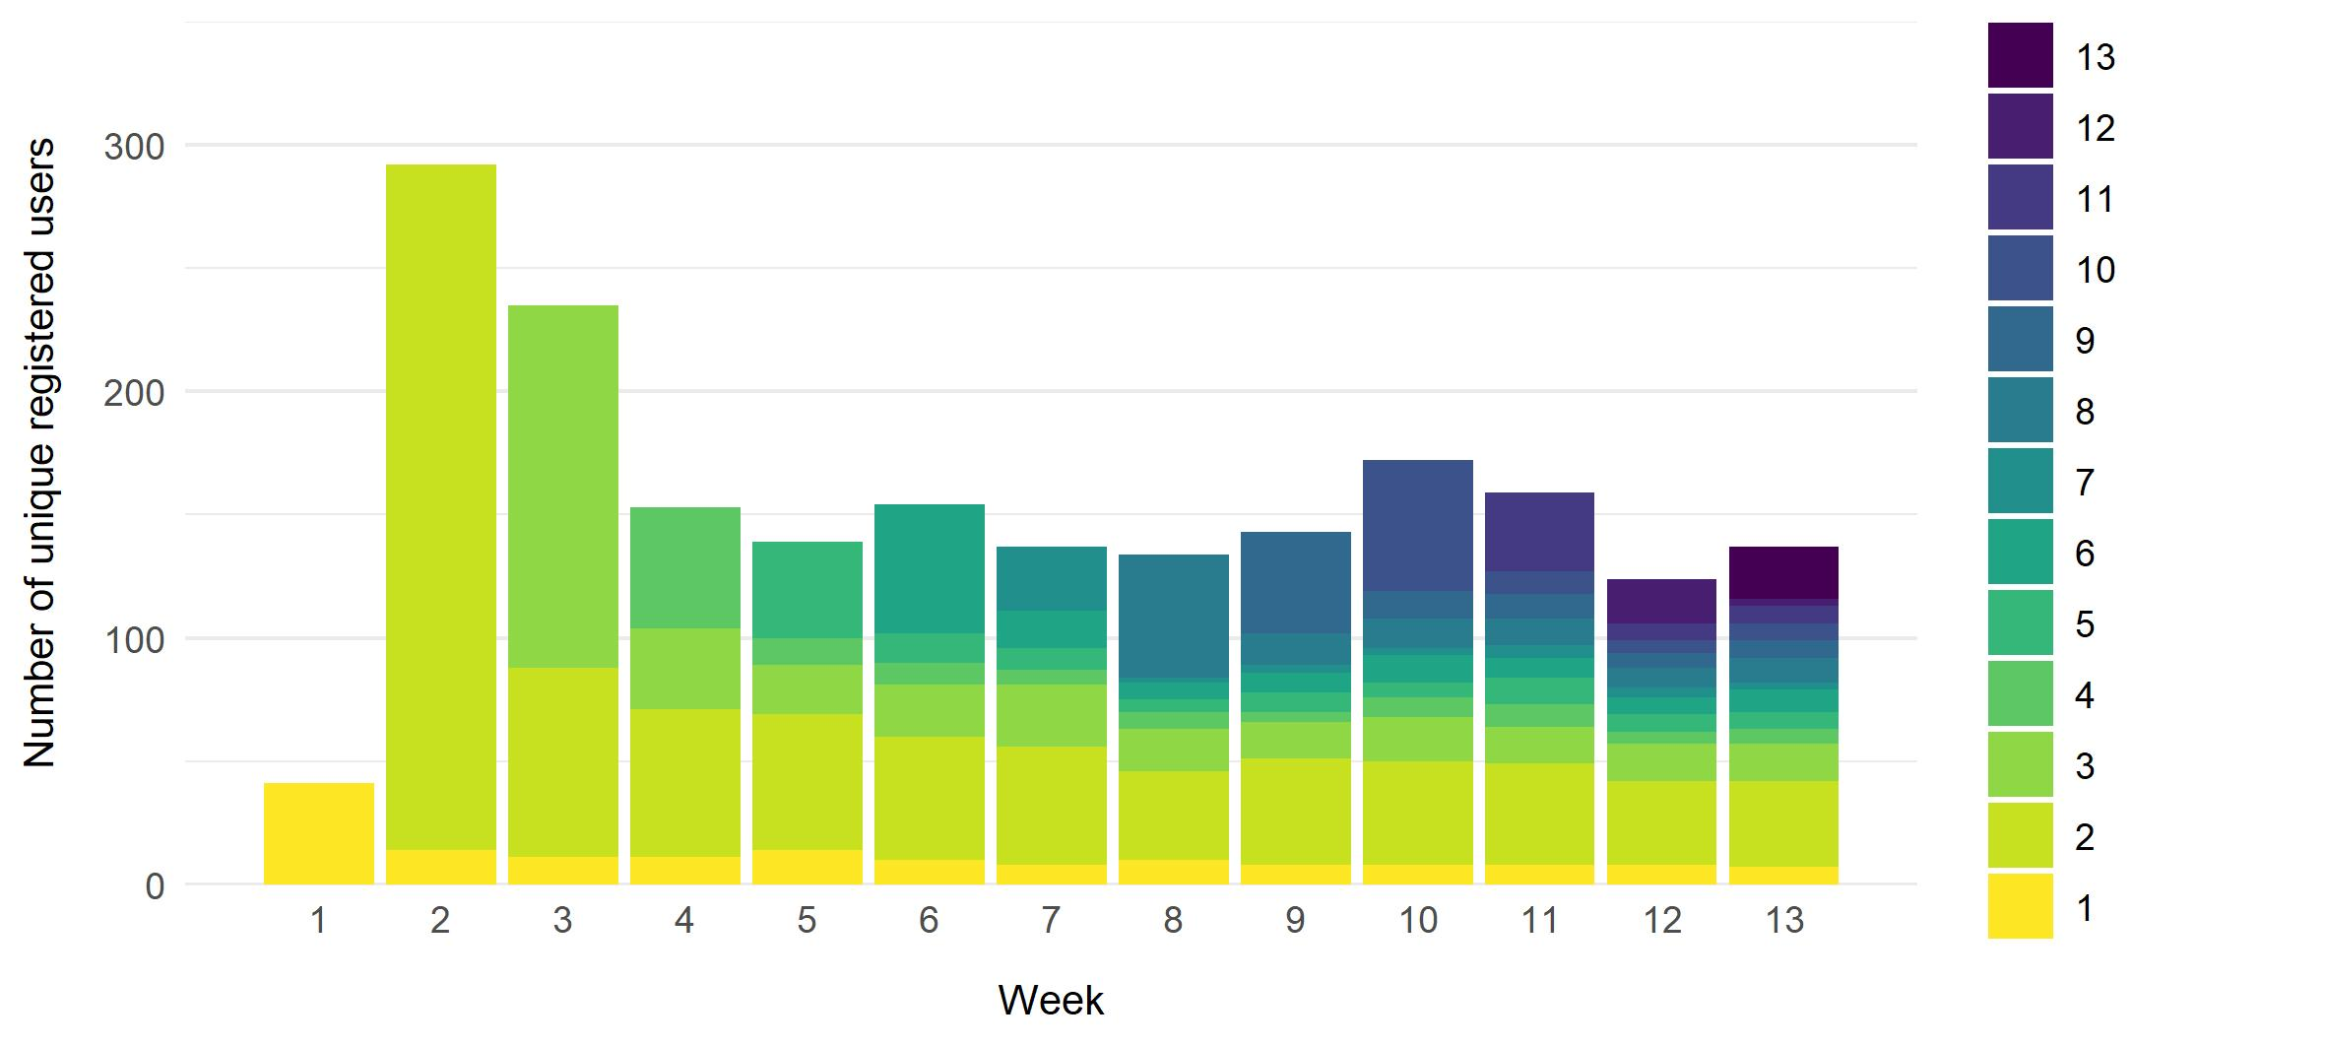
Serialization (registered users)
Week of registration

Slide 38
Serialization (registered users)
Why do users come back?

Slide 39
Serialization (registered users)
Return rate = Number of registered users with more than one session / number of registered users): 45.8%
Number of sessions: 4 sessions for registered users
Around 4 « active weeks » for registered users
Time on Site between Week 4 and 13:
62 minutes for registered users
8.7 minutes for unregistered users
Moneycracy | Grozny Nine Cities | Hollow | Journey … Coal | Prison Valley
4.5 minutes | 3 minutes | 5/6 minutes | 9 minutes | 20% of registered users: 59 minutes

Slide 40
Implications
Serialization was efficient:
Consider serialization to increase time on site and amount of content consumed, esp. for registered users
Newsletter efficient to keep people engaged over time
Make people register (as soon as possible)

Slide 41
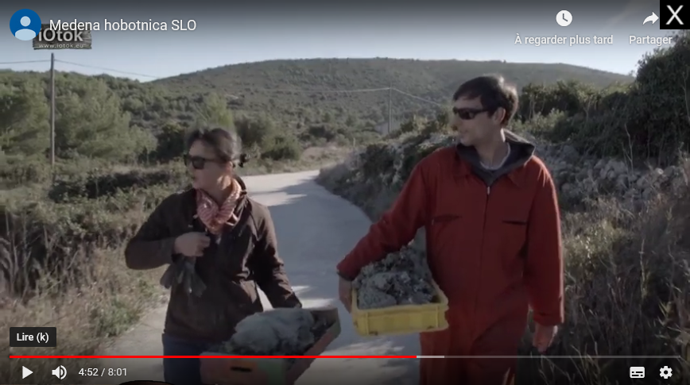
Videos

Slide 42
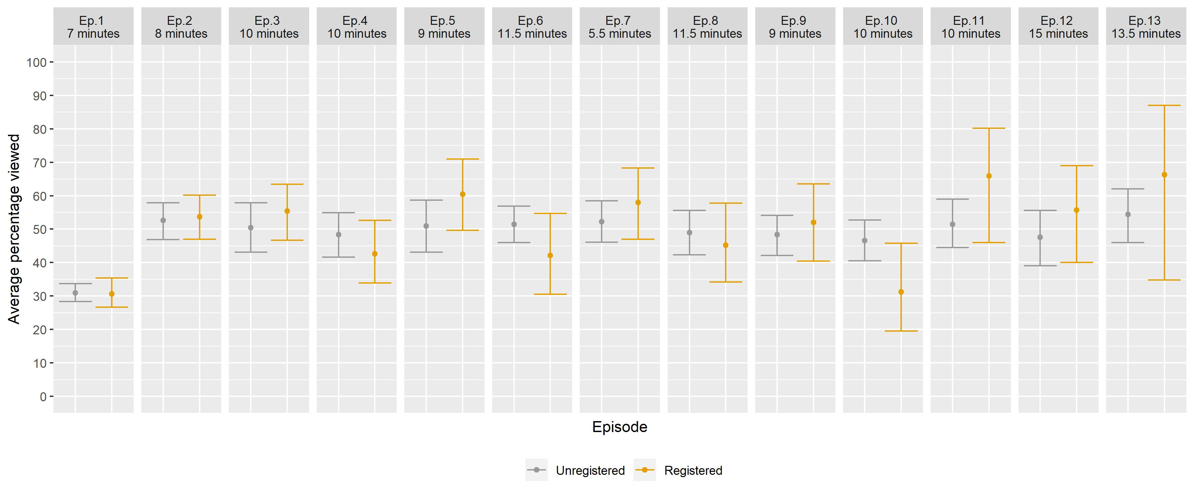
Do people actually watch videos?

Slide 43
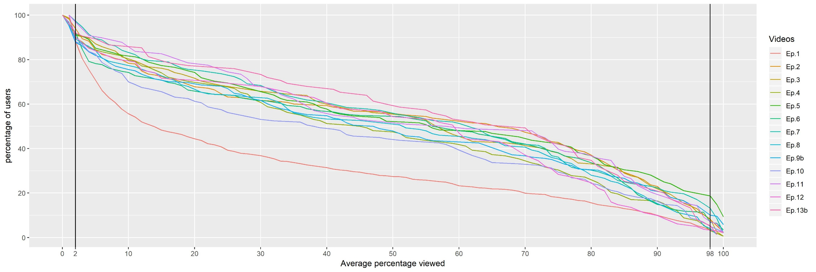
Do people actually watch videos?
Are those good values? Yes… for long videos
IMPLICATIONS: Shorten videos / Enable users to skip parts of the videos?

Slide 44

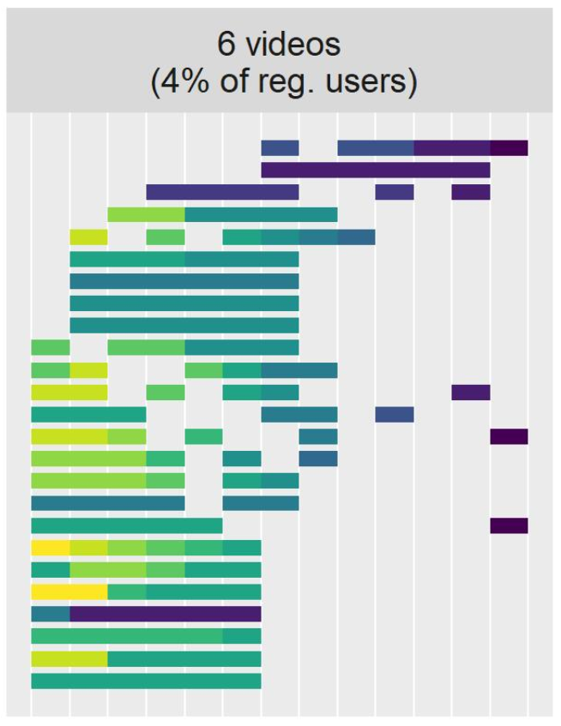
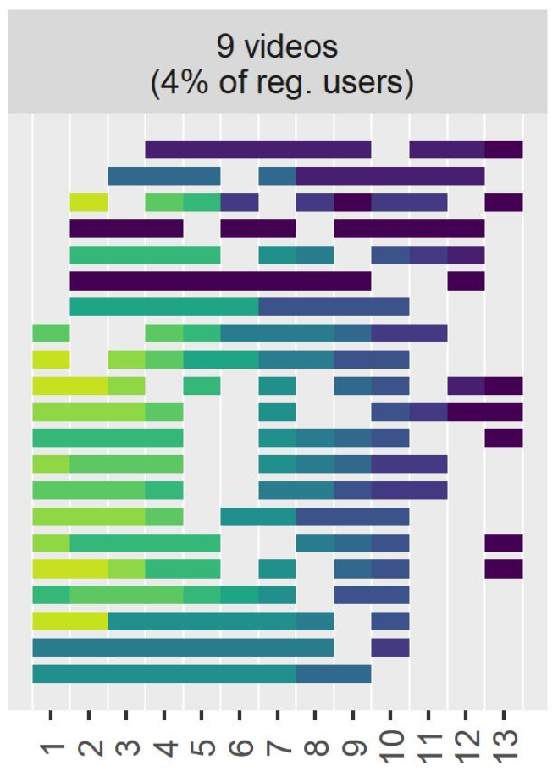
Viewing behaviors
Color <> week
Users
Videos
Videos

Slide 45
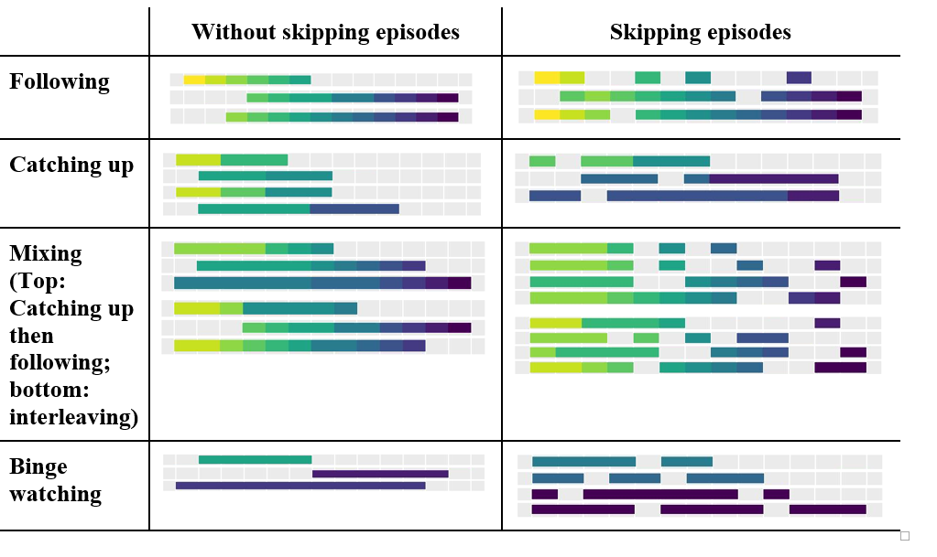
Viewing behaviors

Slide 46
Viewing behaviors
7%
8%
63%
18%
Undefined: 4%

Slide 47
Implications
Facilitate navigation between episodes
Design for specific groups of users:
binge-watchers: provide users with a direct access to episodes
skippers: provide summaries of last episodes.
To be explored further:
Viewing behaviours when all the episodes are already online?

Slide 48
Conclusion

Slide 49
Potential visitors (worldwide)
Potential visitors (croatian and slovene speakers only)
People who heard about the documentary through Fb or online articles
Desktop users (60%)
Users who enter the episode
(50% of unregistered users!)
INTERACTIVITY
Users who reach the video
(80% of reg.; 30% of unreg)
Users who finish the video
Users who understand/care

Slide 50
Take-home messages
Designing for mobiles could really increase the pool of users (e.g. less clicks + by enabling people to switch between desktop and mobile).
Social media and online articles cannot be ignored.
Every click lead to users dropping off, esp. for the first episode
Serialization is a good option (esp. combined with newsletter) but the number of episodes should be chosen carefully.
Different types of users should be considered: e.g. unregistered vs registered; followers vs binge-watchers. Content could/should be designed accordingly.

Slide 51
Future work
What happened? What is happening? (short & long-term analyses)
Questionnaires
Press coverage
Interviews
Analysis of Online communities (Pokret Otoka)
Chat messages / Facebook comments
Effect of the release of the feature-length documentary?
Analysis of policies / votes
People are accessing the website
People consume & understand the content
Change of mind/behaviors/structures

Slide 52
Other results

Slide 53
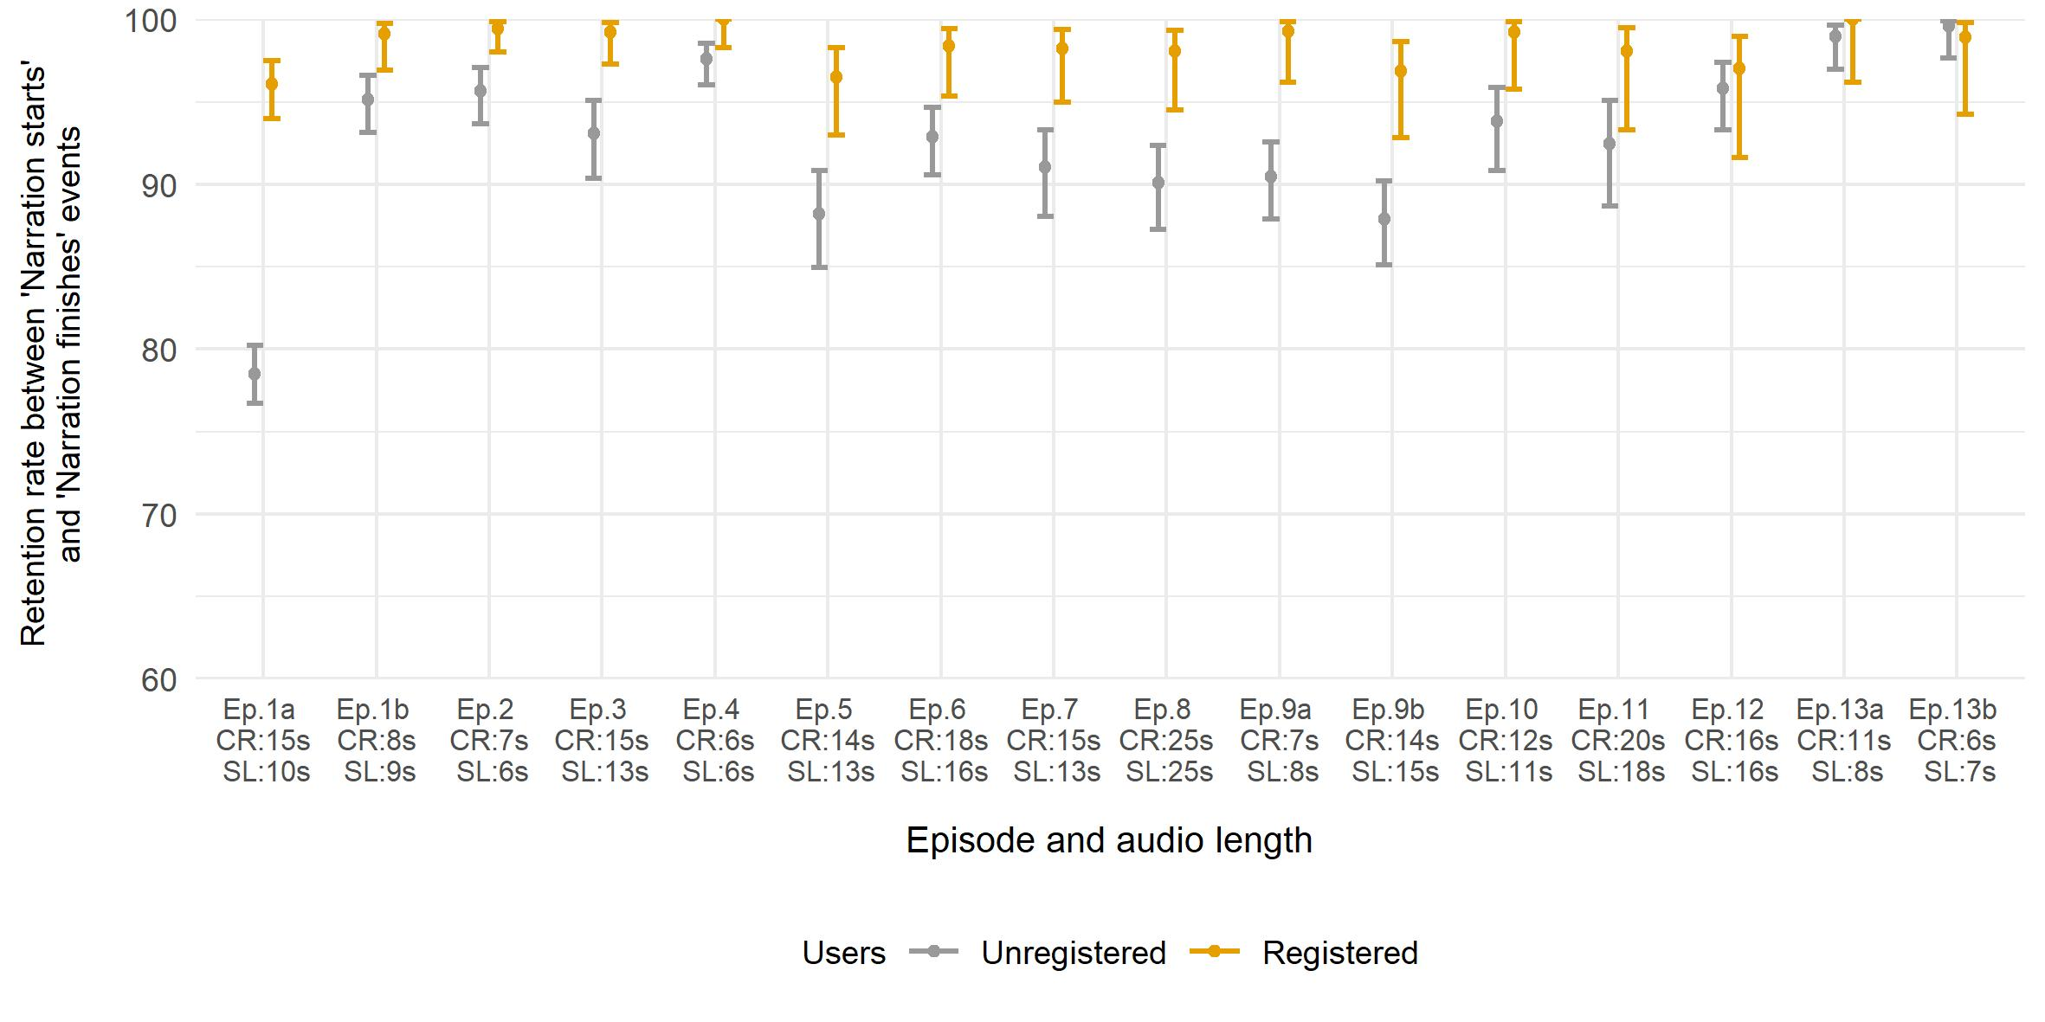
Audio narrations

Slide 54
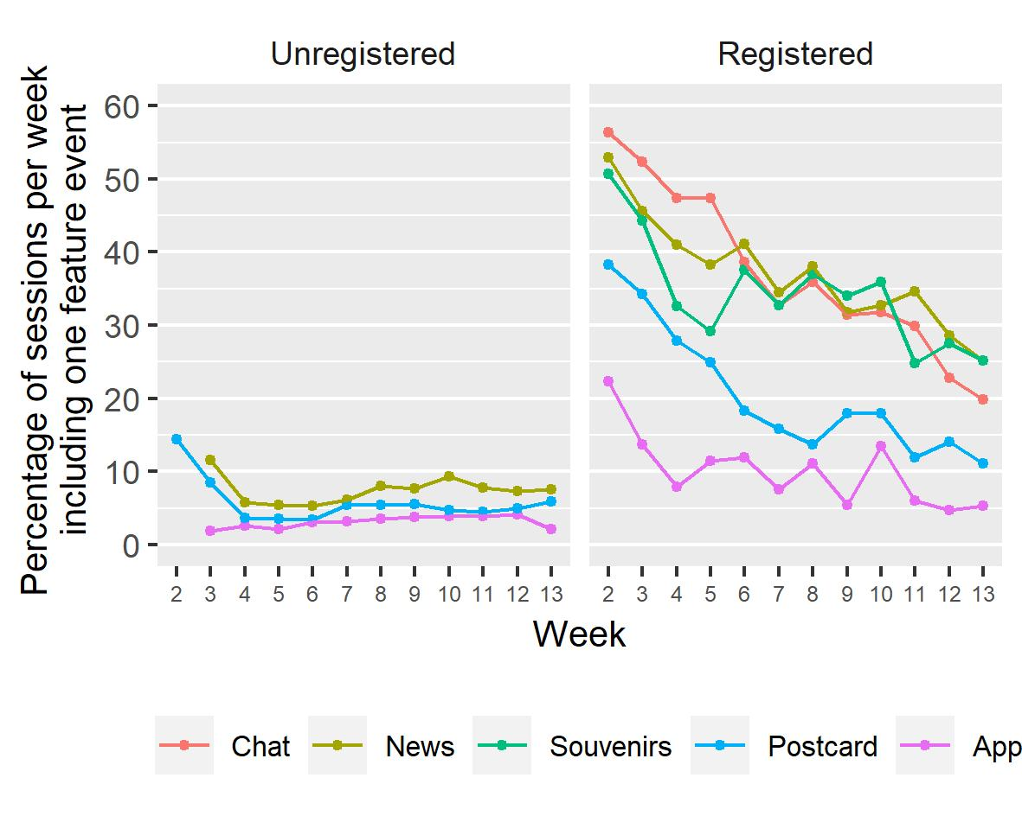
Features

Slide 55
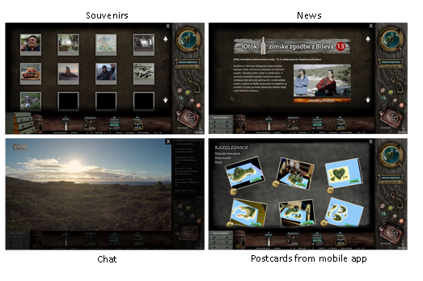
Additional features

Slide 56
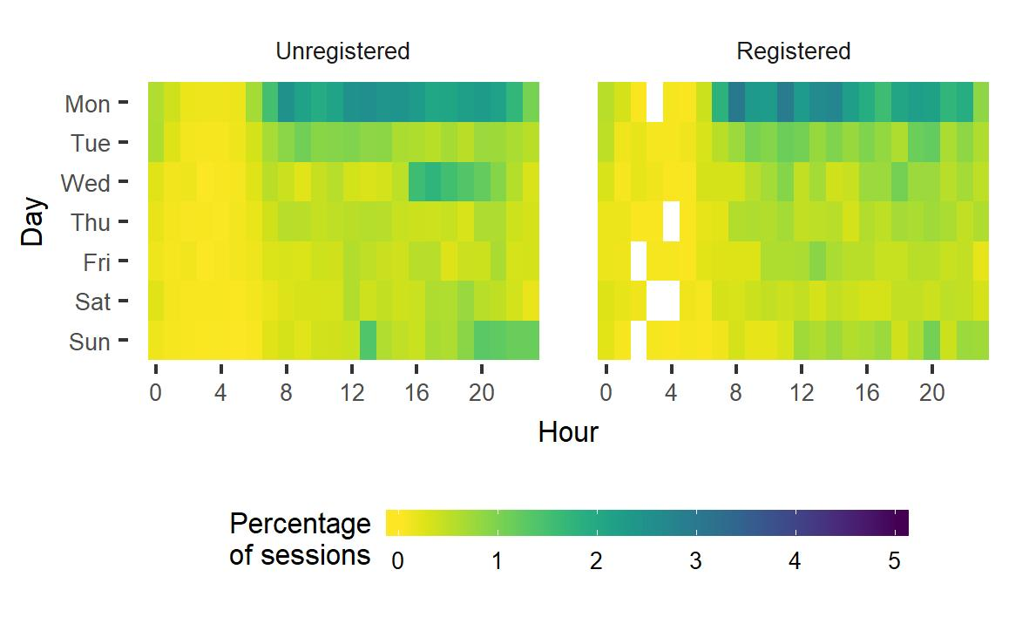
Newsletter?
Direct 51%
Referral: Punfunker.hr 3%
Referral: RTVSLO 3%
Referral:
others 3%
Organic
search:
3%
Social media:
Others (1%)
MailChimp

